Slide 1
Maths
Unit 1.1 – Place Value
18.08.2026
WALT: Understand and explain the value of each digit in decimals.

Slide 2
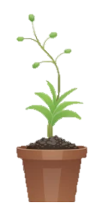
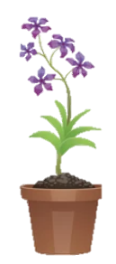
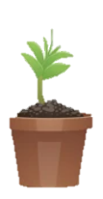
WALT: Understand and explain the value of each digit in decimals.
I can read numbers correctly to three decimal places.
I can identify the value of digits in a number correctly to three decimal places.
I can find and correct the mistakes in the work of others.

Slide 3
Homework
Complete pages 9 – 13 in your Workbooks.
Due – Tuesday 25th August 2026.

Slide 4
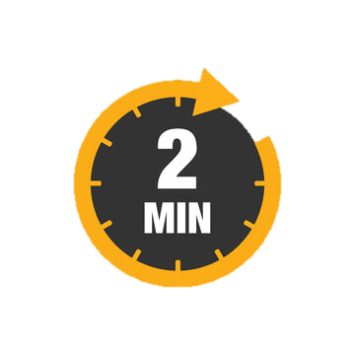
Retrieval Practice –
WALT: Understand and explain the value of each digit in decimals.
Talk to your partner.
What did you learn to do in maths in grade 4?
What did you find the most challenging?
Now swap

Slide 5
Starter –
WALT: Understand and explain the value of each digit in decimals.
What does these words mean?
Decimal Decimal point
Decimal place
Place value

Slide 6
How would you say this number?
WALT: Understand and explain the value of each digit in decimals.
5,972.593
What is the value of each of these digits?
C
A
B

Slide 7
WALT: Understand and explain the value of each digit in decimals.
5,972.593
What is the value of each of these digits?
C
A
B
A = 5 tenths
B = 9 hundredths
C = 3 thousandths

Slide 8
WALT: Understand and explain the value of each digit in decimals.
89,324.328
What is the value of each digit after the decimal point?
3 tenths 0.3
2 hundredths 0.02
8 thousandths 0.008

Slide 9
WALT: Understand and explain the value of each digit in decimals.
713.043
What is the place value of the 4?
hundredths

Slide 10
WALT: Understand and explain the value of each digit in decimals.
Take it in turns to read the following numbers to your partner.
56,327.56
345.639
12.502
813,593.008
437.170
Write the value of the under-lined digit in each of the following numbers.
f) 56,327.56
g) 345.639
h) 12.502
i) 813,593.008
j) 437.170
k) Ms. Colette reads the number 17.539 out loud. She says:
“The number is seventeen point five-hundred and nine. The three is worth hundredths.”
Is she correct?
What mistake(s) has she made?

Slide 11
WALT: Understand and explain the value of each digit in decimals.
Take it in turns to read the following numbers to your partner.
56,327.56
345.639
12.502
813,593.008
437.170

Slide 12
WALT: Understand and explain the value of each digit in decimals.
Write the value of the bold digit in each of the following numbers.
f) 56,327.56
g) 345.639
h) 12.502
i) 813,593.008
j) 437.170
6 hundredths 0.06
6 tenths 0.6
2 thousandths 0.002
0 hundredths / 0
1 tenth 0.1

Slide 13
WALT: Understand and explain the value of each digit in decimals.
Ms. Colette reads the number 17.539 out loud. She says “The number is seventeen point five-hundred and nine. The three is worth hundredths.”
Is she correct?
What mistake(s) has she made?
She is not correct
The number is “seventeen point five three nine”
The three is worth 3 hundredths.

Slide 14
WALT: Understand and explain the value of each digit in decimals.
I can read numbers correctly to three decimal places.
I can identify the value of digits in a number correctly to three decimal places.
I can find and correct the mistakes in the work of others.

Slide 15
Plenary – Which of the following is the odd one out? Why?
WALT: Understand and explain the value of each digit in decimals.
5.628
5628 thousandths
56 tenths and 28 thousandths
56 hundredths and 28 tenths

